Slide 1
Impact of NIS2 and DORA to trust service providers operating in several Member States eIDAS 2.0: Challenges of digital transformation – where are we going?
Vilnius/online 2024.04.24
Jon Ølnes
Tribe Lead Signing and Trust Services Director Signicat
2108PCO1.1

Slide 2
Disclaimer
Please note that this presentation is for information purposes only, and that Signicat has no obligation to pursue any course of business outlined in this presentation or to develop or release any functionality mentioned in this presentation.
The future strategy and possible future developments by Signicat are subject to change and may be changed by Signicat at any time for any reason without notice. This document is provided without a warranty of any kind, either express or implied, including but not limited to, the implied warranties of merchantability, fitness for a particular purpose, or non-infringement. Signicat assumes no responsibility for errors or omissions in this document.

Slide 3
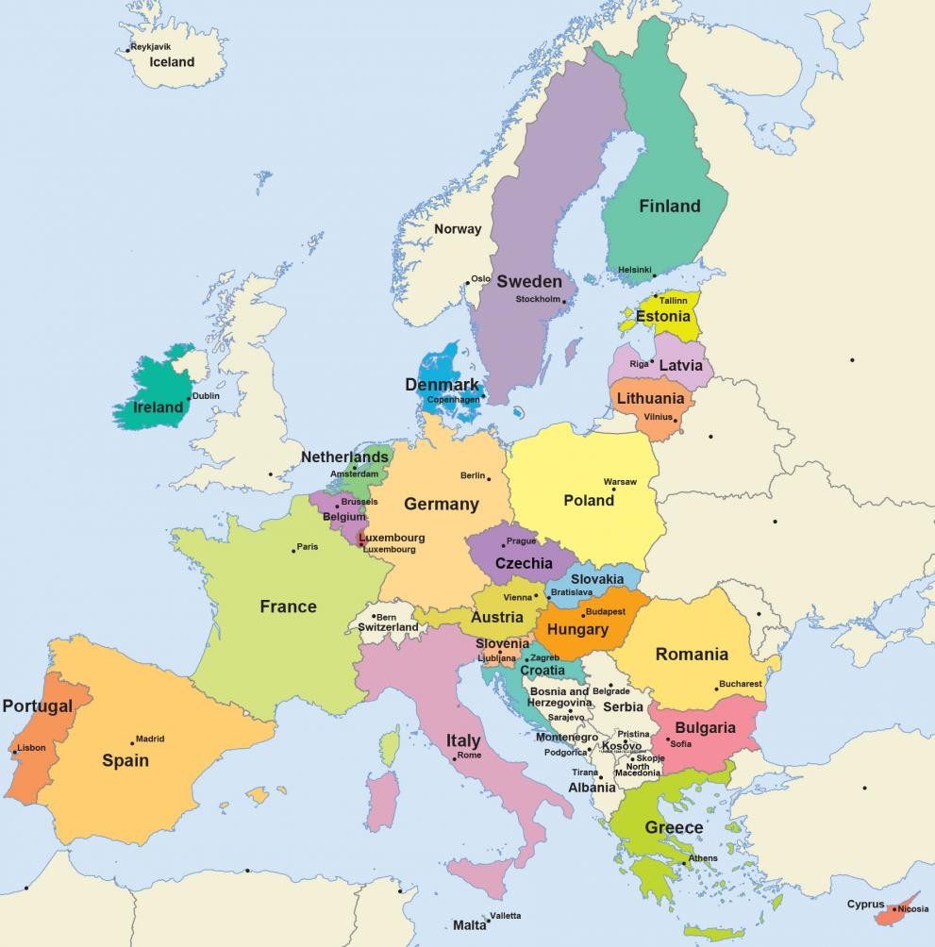
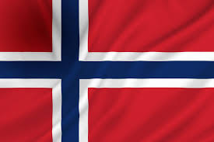


Signicat as trust service provider
Q-timestamp
Q-validation
Also non-qualified trust services
Q-cert for signing
Remote QES
Linked to Spanish LINCE certification
3 different CABs
3 different superv. authorities

Slide 4
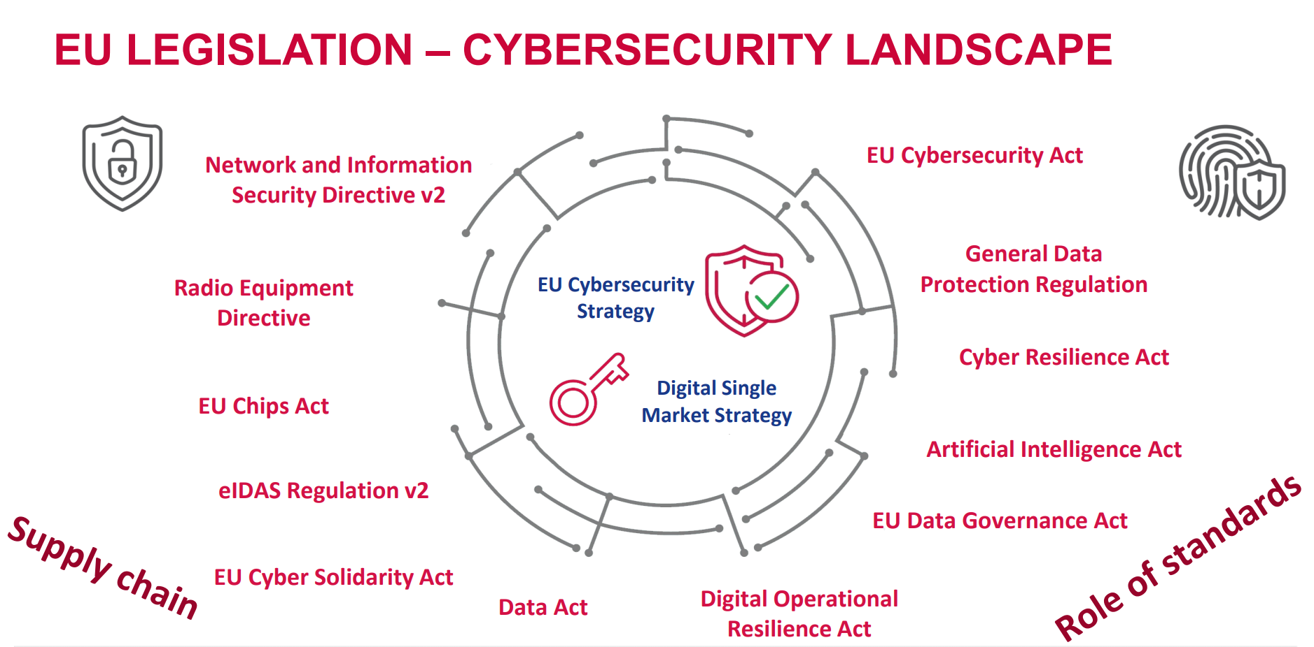
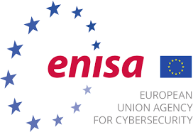
Source ENISA

Slide 5
EUCC certification schemes in the future? E.g. biometrics
QTSPs are Essential Entities
QTSPs handling personal data
QTSPs serving financial sector

Slide 6
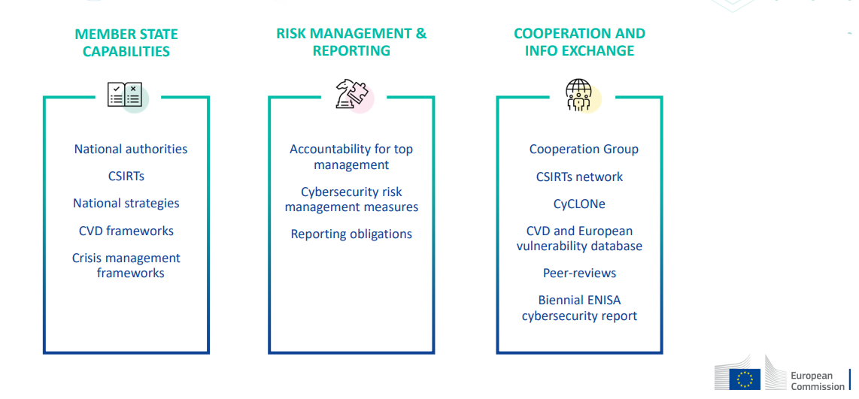

NIS2 and (Q)TSPs
QTSPs, regardless of size, are essential entities
TSPs are important entities
eIDAS is Regulation, common EU law
NIS2 is Directive, implemented in national laws
Will we face different national requirements for NIS2?
One more supervisory authority?
Granting and withdrawal of Q-status
Supervisory body co-operation needed – between eIDAS and NIS2 bodies and across borders
QTSP audits shall cover NIS2
CAB requirements/accreditation?
Supply chain control is essential
Liabilities from both eIDAS and NIS2
eIDAS v2 risk management and incident reporting refers to NIS2

Slide 7

Policy and security requirements for trust services
EN 319 403-1
TSP Conformity
Assessment
New version under national ballot
Incorporating NIS2 requirements
Incorporate latest ISO/IEC 27002
EN 319 401
General,
any type of TSP
Based on
ISO/IEC 27002
Ref
EN 319 411-x
Certification Authority
EN 319 421
Time-stamping
TS 119 431-1/-2
Signature creation
TS 119 441
Signature validation
TS 119 461
Identity proofing
TS 119 511
Preservation
EN 319 521
Electronic registered
delivery
EN 319 531
Registered electronic
mail (REM)
TS 119 471
Attribute attestation
TS 119 541
Ledger
TS 119 xxx
Archive
New trust services from eIDAS v2

Slide 8
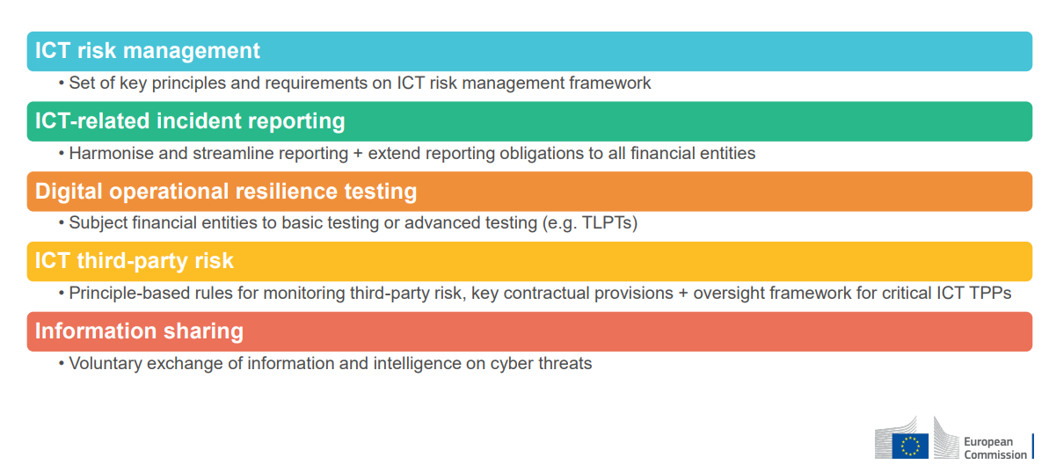
DORA and (Q)TSPs
Common EU rules for all financial service providers
EU financial supervisory authorities (ESA):
EBA (banking), ESMA (securities & markets), EIOPA (insurance and occupational pensions)
Technical standards (RTS, ITS) to be defined
Substitutes (overrides) NIS2 where relevant
Management and Board responsible
Reports to national financial authorities, not to NIS supervisors
Can QTSPs be critical TPPs?
Implies supervision by ESAs

Slide 9
Conclusions
Cybersecurity regulation is complex
Harmonization is sought but not perfect
Multiple supervisory authorities
Multiple reporting, e.g. of incidents
Can be difficult to determine what applies
If successful, EU security will be better than rest of the world
Is the balance security vs cost correct?
Will EU suppliers be hampered in a global market?
Or will the security be an advantage?
High bar for foreign actors to enter Europe
(Q)TSAs are subject to several regulations
Which ones depends partly on the (Q)TSAs market
The bar is raised – may be increasingly difficult for SMEs(?)

Slide 10

Thank you!
Jon Ølnes
Tribe Lead Signing & Trust Services
jon.olnes@signicat.com

